Slide 1
HERO SCREEN LIST 27inch

Slide 2



Slide 3
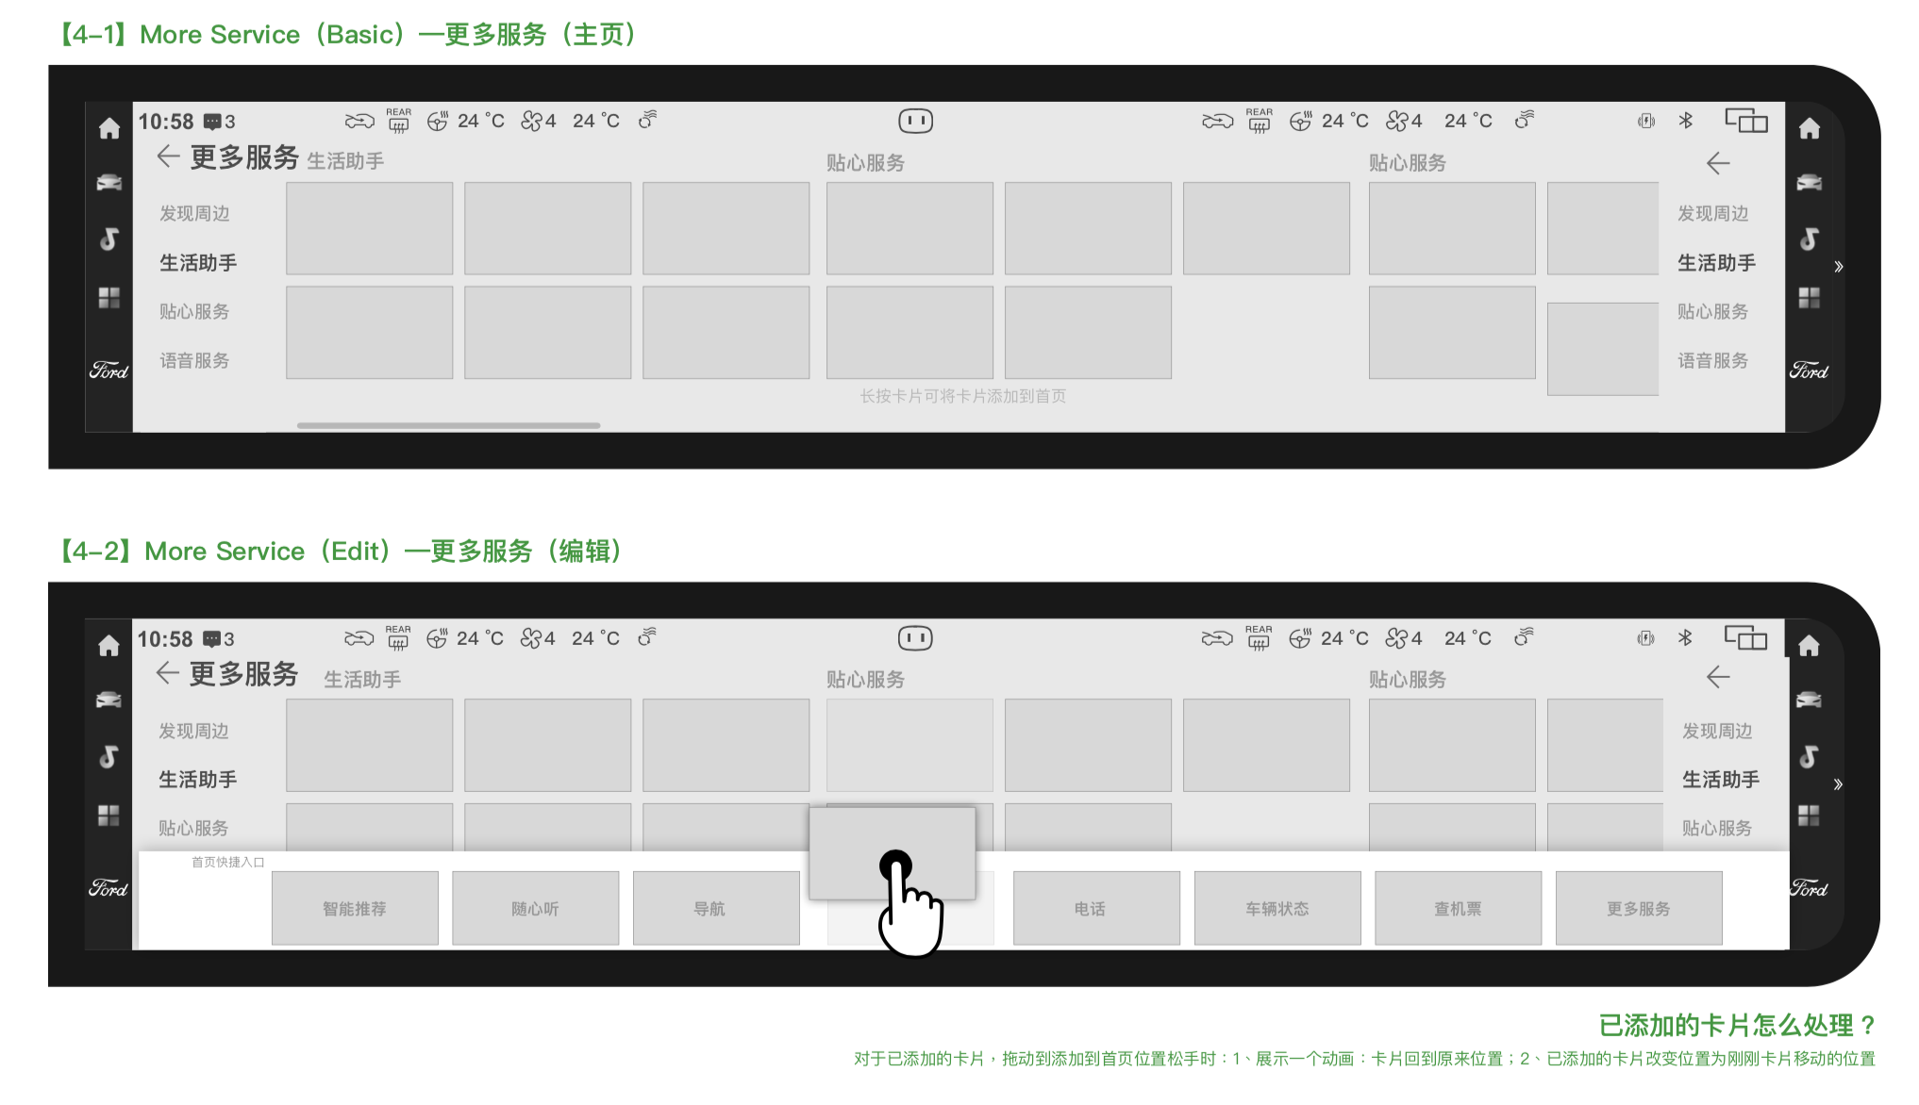

Slide 4



Slide 5
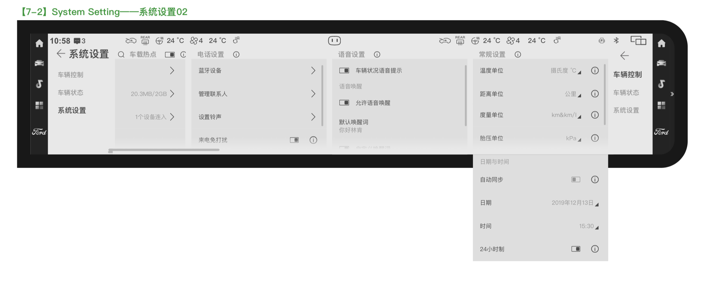

Slide 6

music

Slide 7
player

Slide 8


Slide 9


Slide 10


Slide 11
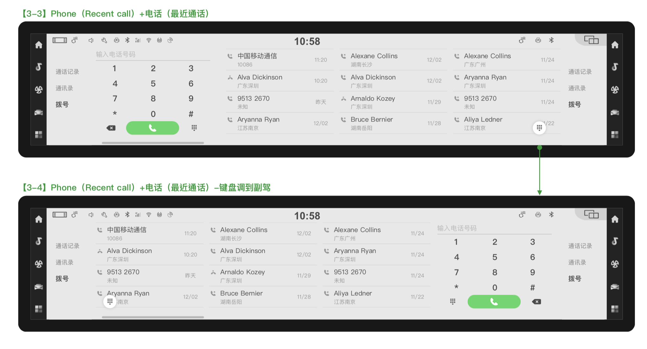

Slide 12
Seat adjustment

Slide 13
Air condition

